Slide 1
PC Hardware Store using Magento
Ivănică Gabriel 345C5

Slide 2

Magento
Open Source Platform
Scalable Platform
Security and Payment Option
Easier Site Management
Reporting and Analytics
SEO - Search Engine Optimization
Supports for Mobile
User Friendly

Slide 3
Hardware Store
Between 10 and 20 categories
A lot of subcategories
Ierarhical subcategorie
Subactegories can have more subcategories
EX: PC Component – Video Card – Professional Cards
Product properties
Product properties
We can have more than 20 different properties
Filtering product

Slide 4
Hardware Store (2)
Product search
Newsletter
Promotions
User accounts + management
Real-time stock
Integration with distributors – rest api
Shipment tracking

Slide 5
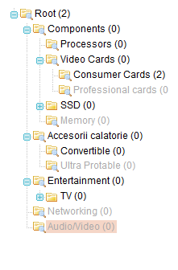
Main categories
Laptop
Tablets
PC Components
Servers and PC Systems
Phones
Audio/Video
Printing
Peripherals
Networking
Electronics

Slide 6
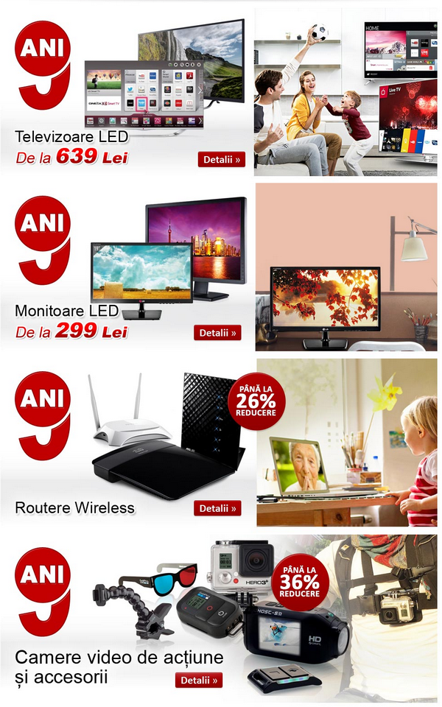
Newsletter
Weekly promotions
Product of the day
Promotion
Black Friday
Cyber Monday
Special events
Templates

Slide 7
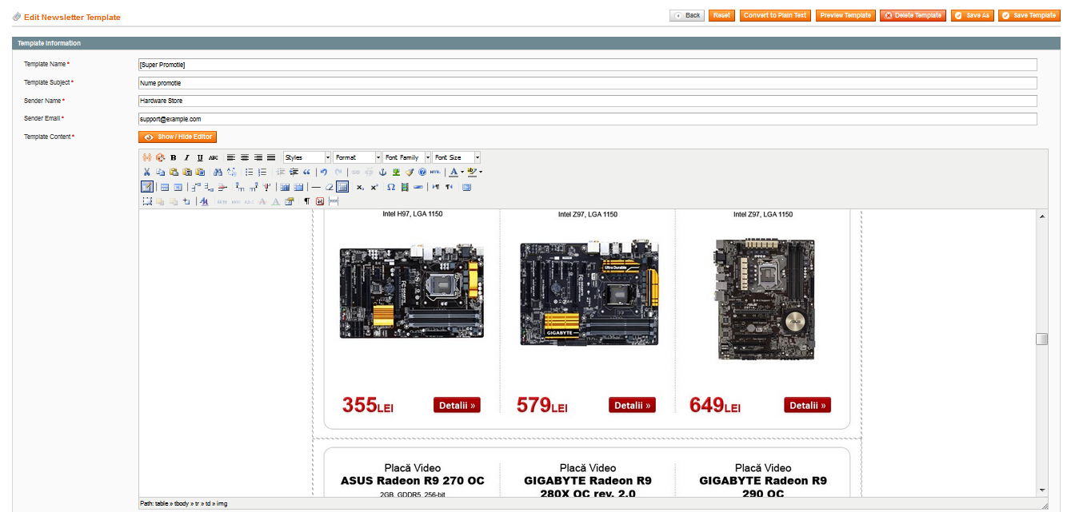

Slide 8
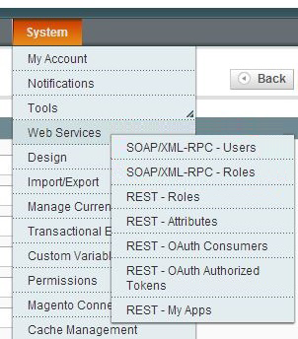
Web Services
Integration with distributors
Support for REST API, XML, SOAP, excel data-bases

Slide 9
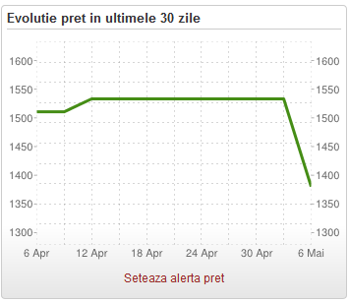
Widgets
Most buyed products
Filter products
Compare products
Frequently bought together products
Sponsored products
Price history

Slide 10
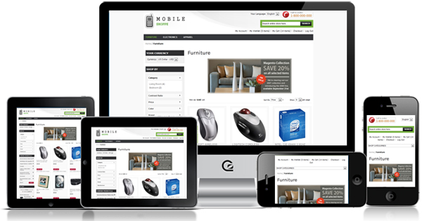
Design and Theme
Responsive design
Mobile Shoppe

Slide 11
Payment and security
SSL security
Magento provides different payment methods
Paypal
Google
Credit cards
We will this with local services such as EuPlatesc.ro, PayU.ro, mobilepay.ro

Slide 12
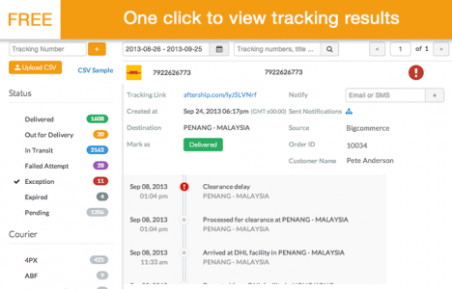
Shipment and Tracking
Service integration from national wide company like FanCourier
Shipment tracking
AfterShip – Auto Tracking & Delivery Notification
Notifications
Email / SMS

Slide 13

Conclusions
Great management and functionality
very easy to set up and integrate with existent APIs
Provides a lot of extensions
great for business extensibility
Open Source

